Slide 1
Baseball
Marko I nikola Vrdoljak
6.a

Slide 2
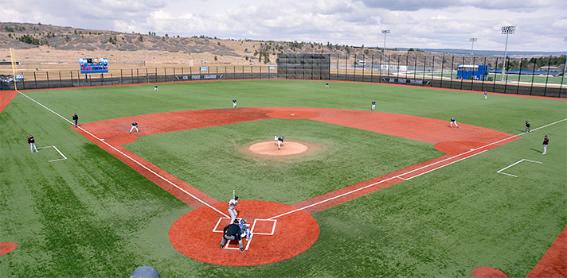
Baseball is played by two teams of 9 each who try to score more runs than their opponents by rounding the bases and crossing home plate as many times as possible

Slide 3
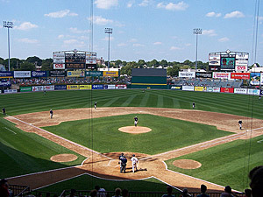
The playing arena is called baseball field. It consists of pitcher's mound, 4 bases, an infield, and an outfield.

Slide 4
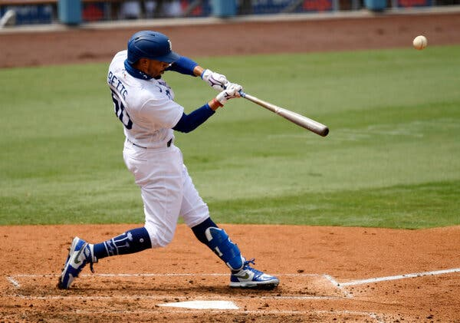
Scoring-the team that scores the most runs is the winner. If the ball is hit over the outfield in fair territory, it is considered a home run. The batter has a free run all way around the bases unti he crosses home plate.

Slide 5
Duration- a standard game lasts 9 innings. Each inning is divided into top and bottom half with each team having a turn at bat

Slide 6
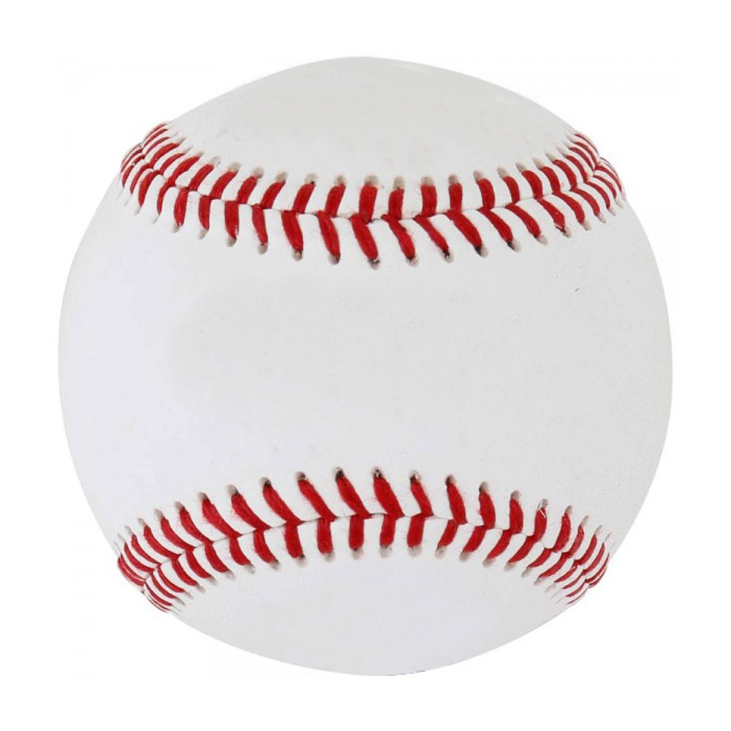
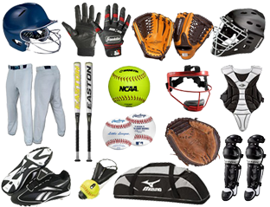
Equipment
bat
batting helmet
baseball
gloves for each outfielder
4 bases
pitching rubber

Slide 7
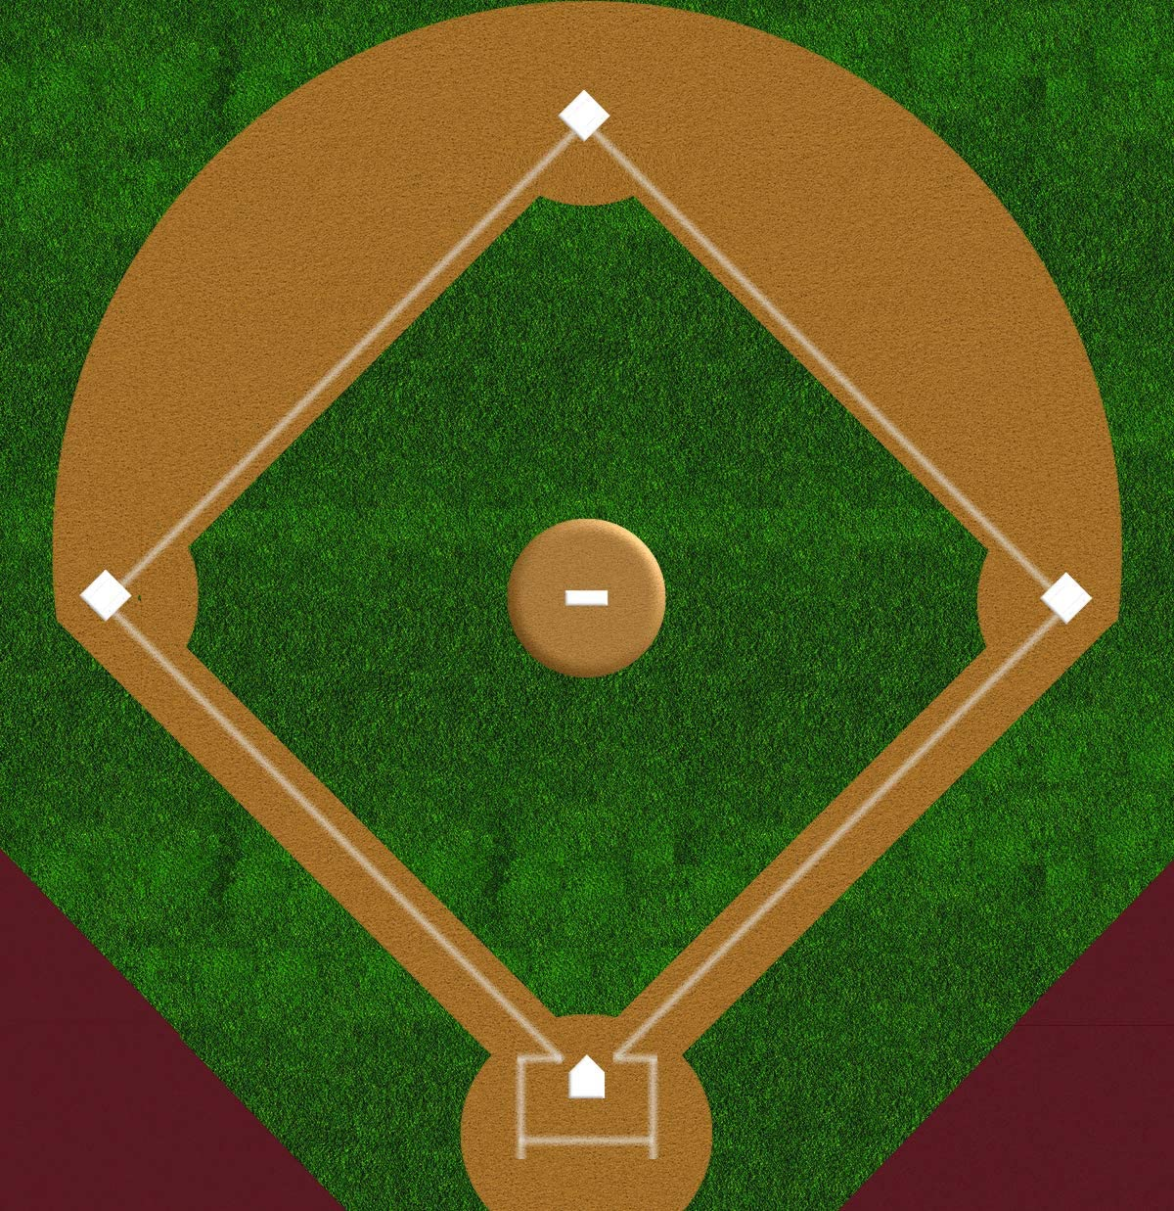
Interesting facts about baseball
The baseball field is called the "diamond" because of the shape of the infield
Baseball was originally called rounders. This was a game that came from England
The first baseball game was played in Hoboken, New Jersey
The oldest ballpark is Fenway park in Boston, home of the Boston Red Sox, which opened in 1912
The "diamond"

Slide 8
Thank you for your attention!
:)
Nikola i Marko Vrdoljak 6.a

